Slide 1
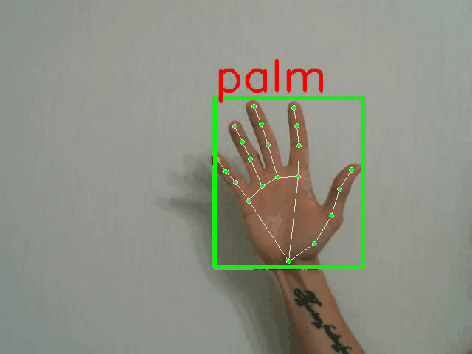
CS512 - COMPUTER VISION
Real-time Hand Gesture Recognition
Source: GitHub-HaGRID dataset
Project Presentation
Spring 2023
Bastien LEDUC - A20520860
Paul LEGOUT - A20522029

Slide 2
Problem Statement

Slide 3
Problem Statement
Implement AI models for live hand detection and gesture recognition.
Example of applications:
Video conferencing services
Home automation systems
Automotive sector
Services for people with speech and hearing impairments, etc.
Human-computer interaction
Paper that we used:
Dataset: HaGRID — HAnd Gesture Recognition Image Dataset
MediaPipe: On-device Real-time Hand Gesture Recognition
Models: Real-time Dynamic Sign Recognition using MediaPipe
Notes:
Hand gestures detection is one of the most common applications of computer vision. These
types of live models can be used for several purposes:
- video conferencing services,
- home automation systems,
- the automotive sector,
- services for people with speech and hearing impairments, etc.
- Human-computer interaction
There are going to be two major parts in this project.
The first part consists of implementing a real-time hand detection system using MediaPipe from
which we will be able to collect and extract information about the different hand poses, such as
hand landmarks and bounding box coordinates.
The second part consists of using the extracted image information to train a hand gesture
recognition classifier, using a CNN.
Once the model is trained, the last part is to incorporate the model in a global application: live
translation from the video stream of our webcam

Slide 4
Proposed Solution

Slide 5
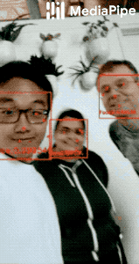
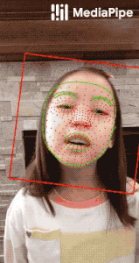
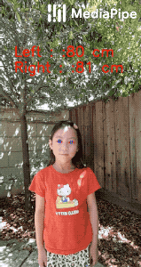
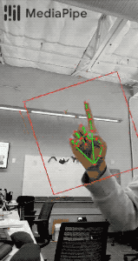
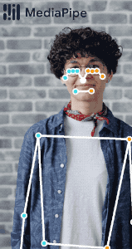
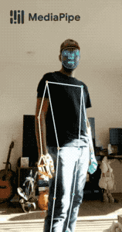
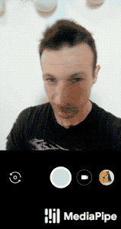
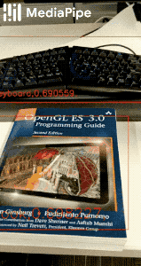
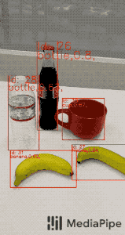
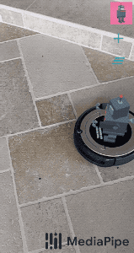
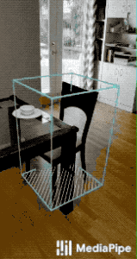
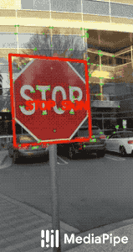
ML solutions in MediaPipe
Face Detection | Face Mesh | Iris | Hands | Pose | Holistic
Hair Segmentation | Object Detection | Box Tracking | Instant Motion Tracking | Objectron | KNIFT

Slide 6
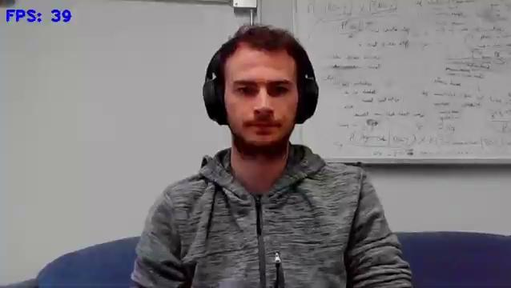
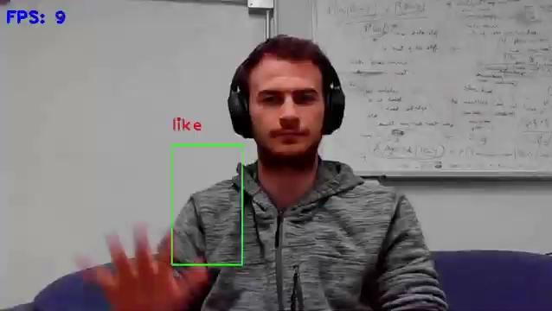
Live Application
MediaPipe Hand Detector (landmarks + boxes) + Conv1D Classifier
1-Hand MobileNet Classifier (boxes + hand gesture)

Slide 7
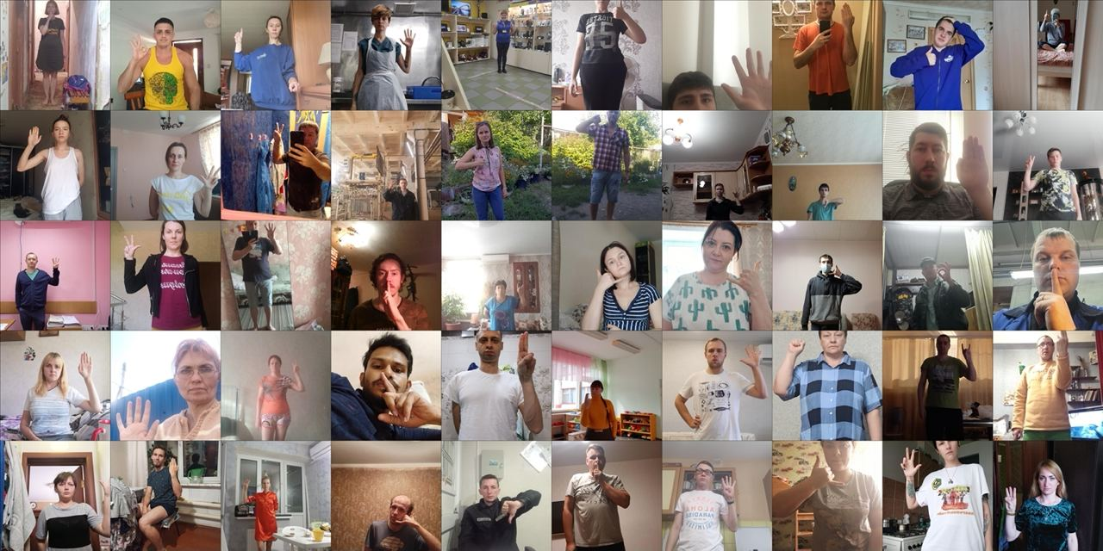
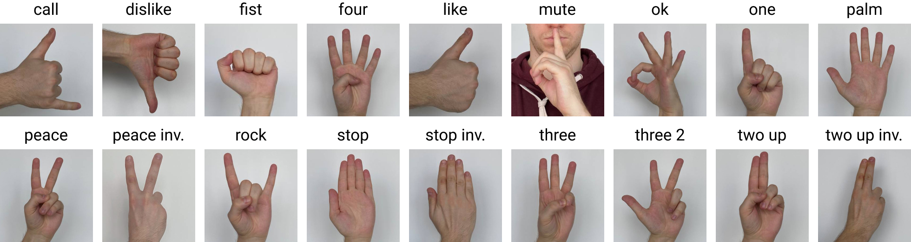
Dataset Presentation
HaGRID – HAnd Gesture Recognition Image Dataset:
Created in June 2022.
Size: 716GB – 552,992 RGB images (with majority FullHD) divided into 18 classes of gestures.
Extra class “no_gesture” with 123,589 samples.
Collected mainly indoors in various conditions
(lighting variations, blur, distance from camera, ...)
Only kept between 2000 and 3000 samples per class.
Include whole set of annotations containing image_ID,
labels, bboxes, leading hand, label.

Slide 8
Pipeline
MediaPipe
Box
Landmarks
Classifier
Conv1D
Class
Custom MediaPipe
Box
Landmarks
Classifier
Conv1D
Class
Display on image
Custom Model
Box
Class
Selected for final application

Slide 9
Implementation Details

Slide 10
Models
MobileNet selected for final application
Base model
VGG16 / MobileNet
Model_1
(box, landmarks)
Model_2
(box, class)

Slide 11
Model_1 (box, landmarks)
Conv2D
Box
Landmarks
Conv1D Block + Reshape
Conv1D Block + Reshape
Flatten
Conv1D Block
Dense Block
Flatten
Dense Block
Concatenate
Dense Block
Output (sigmoid)
Loss: Mean Squared Error
Metric: IoU
Output (sigmoid)
Loss: Huber Loss
Metric: Cosine Similarity

Slide 12
Model_2 (box, class)
MaxPooling2D
Box
Class
Conv1D Block + Reshape
Conv1D Block + Reshape
Flatten
Conv1D Block
Dense Block
Flatten
Dense Block
Output (sigmoid)
Dense Block
Loss: Mean Squared Error
Metric: IoU
Output (softmax)
Loss: Categorical Cross Entropy
Metric: Accuracy

Slide 13
Results & Discussion

Slide 14
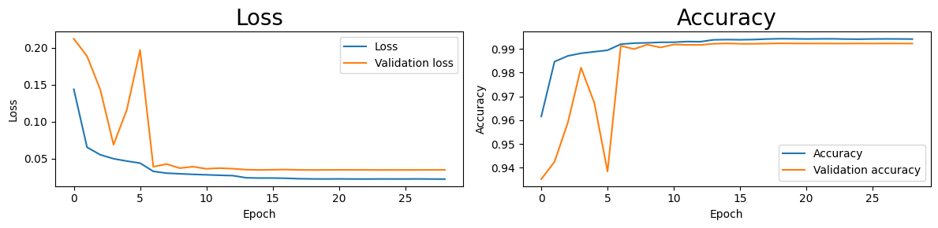
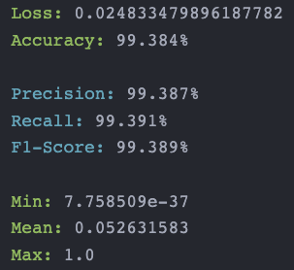
Classifier (Conv1D)
Trained on more than 490,000 landmarks from dataset annotations

Slide 15
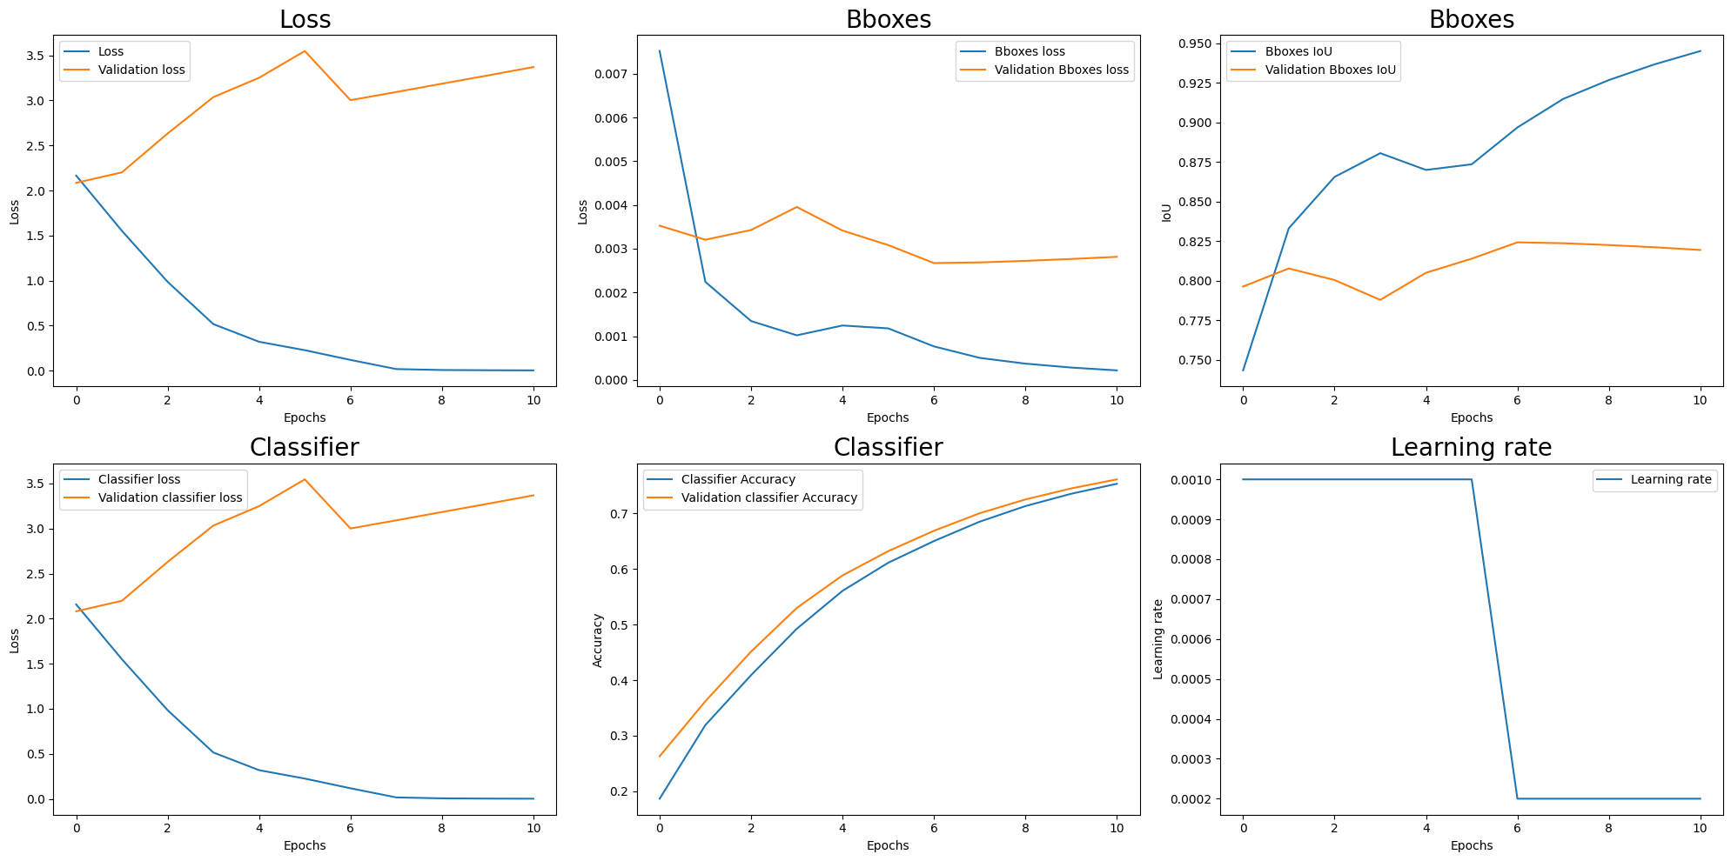
Model – MobileNet (box, class)
Trained on more than 32,000 images

Slide 16
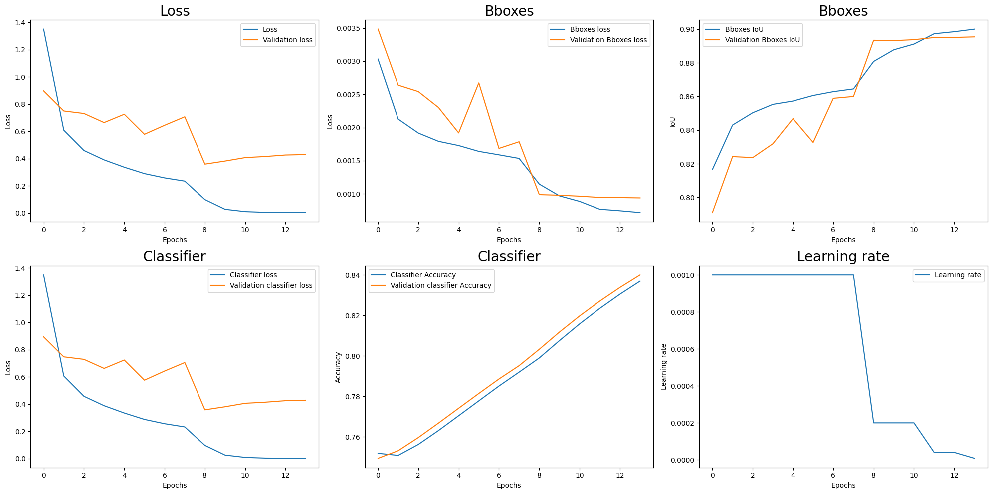
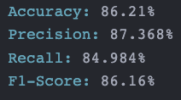
Model MobileNet (box, class) - Fine tuning

Slide 17
Problems & Conception choices

Slide 18
Model architecture and number of parameters
Goal: predictions from live video => need efficiency
=> Discarded VGG16 as base model
=> Selected MobileNet as base model

Slide 19
From custom MediaPipe to complete custom model
First: Implementation of the classifier from MediaPipe output landmarks
We wanted to implement custom MediaPipe to simply replace it by our model, predict the landmarks and use the same classifier as above
Problem: Predicted landmarks were not accurate enough to get a good accuracy
Solution: Custom model, predicting box and class

Slide 20
Dataset size
Classifier trained on more than 490,000 landmarks (21x2), from dataset annotations
Problem: Train CNN on 490,000 images very computer intensive
Solution: Sample the data ( ~ 40,000 images)

Slide 21
MobileNet input size
MobileNet takes an input shape (224, 224, 3)
Problem: Various sizes of the images from the dataset: from more than 1920x1080 to less than 480x270
Solution: Downsample and resize images
> 1920x1080
> 1920/2 x 1080/2 = 960x540
> 1920/4 x 1080/4 = 480x270
Resize 1920x1080
Downsample factor 2
Resize 960x540
Downsample factor 2
Resize 480x270
Downsample factor 2
Resize 224x224

Slide 22
Thank you for your attention
Do you have any questions?

